Slide 1

INFOB302 - Introduction à la démarche scientifique TP 2 : Caractérisation d'un état de l'art 05/03/26
Jérôme Maquoi
jerome.maquoi@unamur.be
Project

Slide 2
Objectives
Paper reading to build a state of the art
Sections to read: Introduction, Background, Related work, Conclusion and Future work
Idea = make connections between what already exists in a domain, to see what has not been done yet
Ok... But how?
Lots of techniques: mindmap, Cornell technique, ...
Proposition of a technique based on what I do for my research: using a Zettelkasten
2

Slide 3
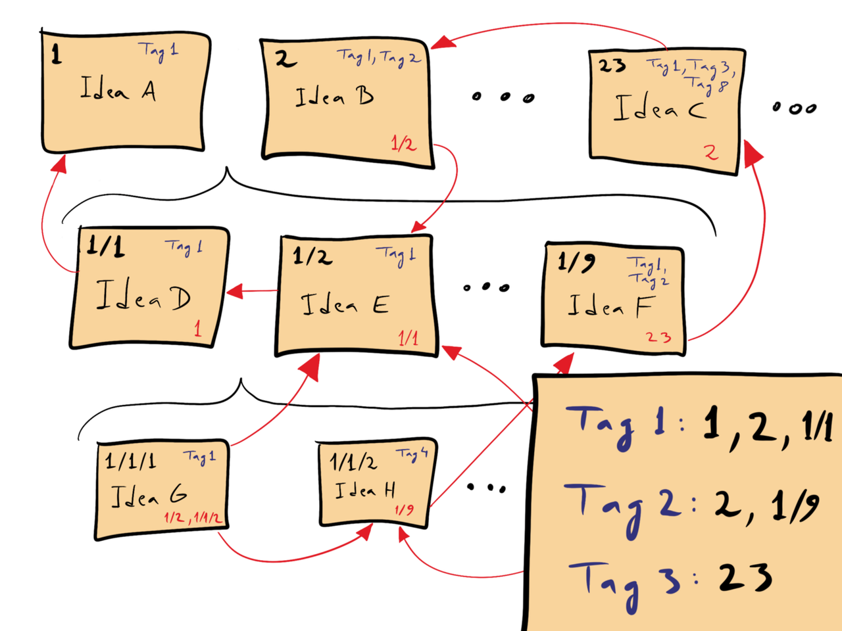
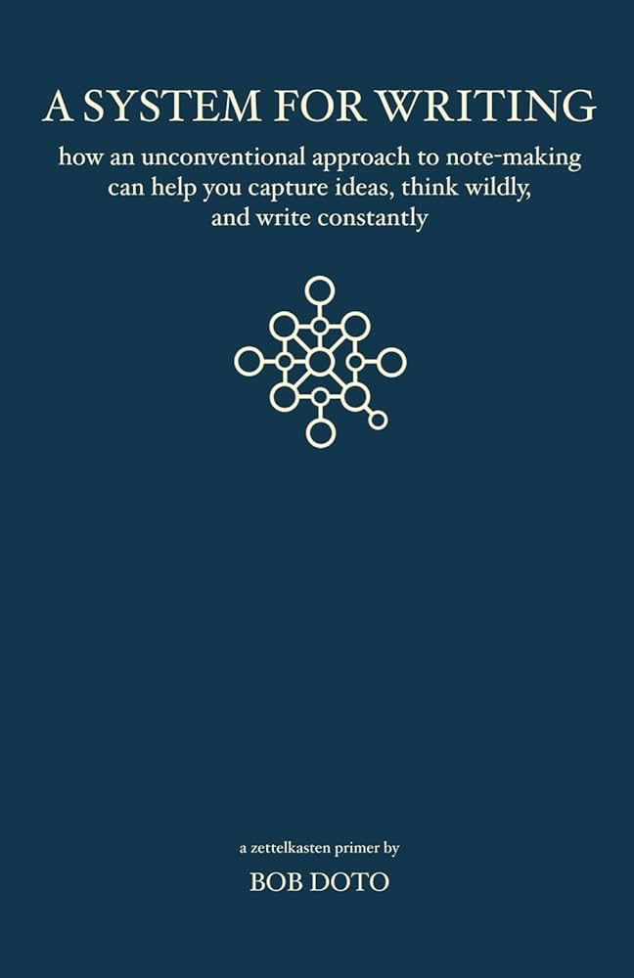
Zettelkasten ? What is this ?
"A Zettelkasten or card file consists of small items of information stored on Zetteln (German: 'slips'; singular: Zettel), paper slips or cards, that may be linked to each other [...]. It has often been used as a system of note-taking and personal knowledge management for research, study, and writing." (Wikipedia)
Each item = one note on a note-taking app (like Obsidian, for example)
3

Slide 4
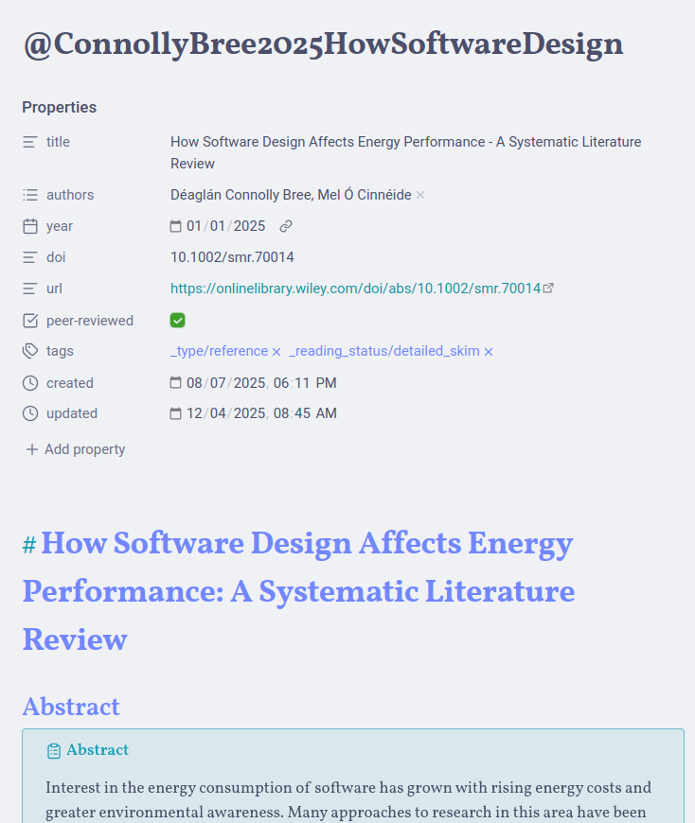
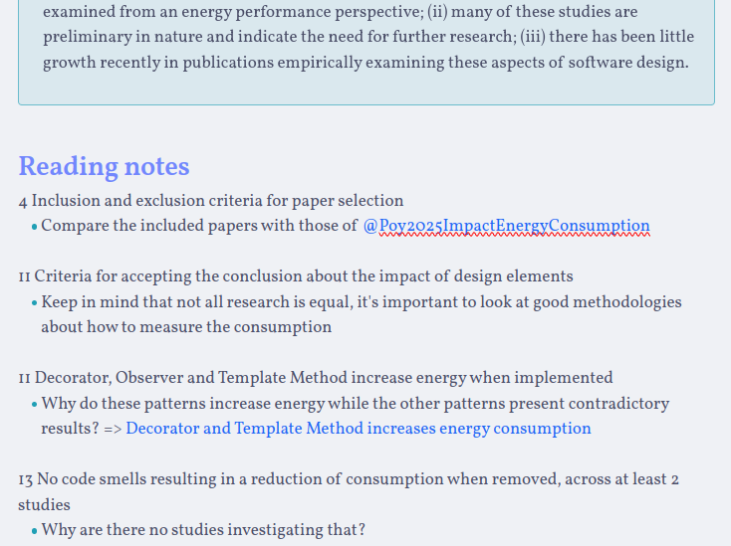
Reference notes
"A reference note is a single long-note containing brief citation or "references" to what cought your attention while reading [...]." (A System for writing, p. 15)
4

Slide 5
Reference notes
How to take reference notes ?
Create a new note with the reference of the paper you are reading (OR take notes directly within the paper)
Begin reading the paper with a purpose in mind (for your: trying to understand a research domain)
When a passage speaks to you: write the page number + brief description of what is said (+ the relation with your thinking)
Things to remember :
Read with a problem or a question in mind
Capture ideas you disagree with
Capture what you think about what the author thinks
Not all notes are gold
Brief description
Relation with my thinking
5

Slide 6
Main notes
Most of the time, we stop at the previous stage
BUT the idea of a Zettelkasten is to use the references notes to create knowledge and new ideas
"Main notes are what your passing captures become. [...] They're the fundamental building blocks of your future writing and the primary components with which you will develop and challenge your thinking." (A System for writing, p. 35)
Main notes are composed of:
A single idea, expressed in your own words, in terms relevant to your interests
Contextual links to other ideas stored in your Zettelkasten that establish various trains of thoughts or arguments
A quote or reference to where the idea comes from
(Tags)
6

Slide 7
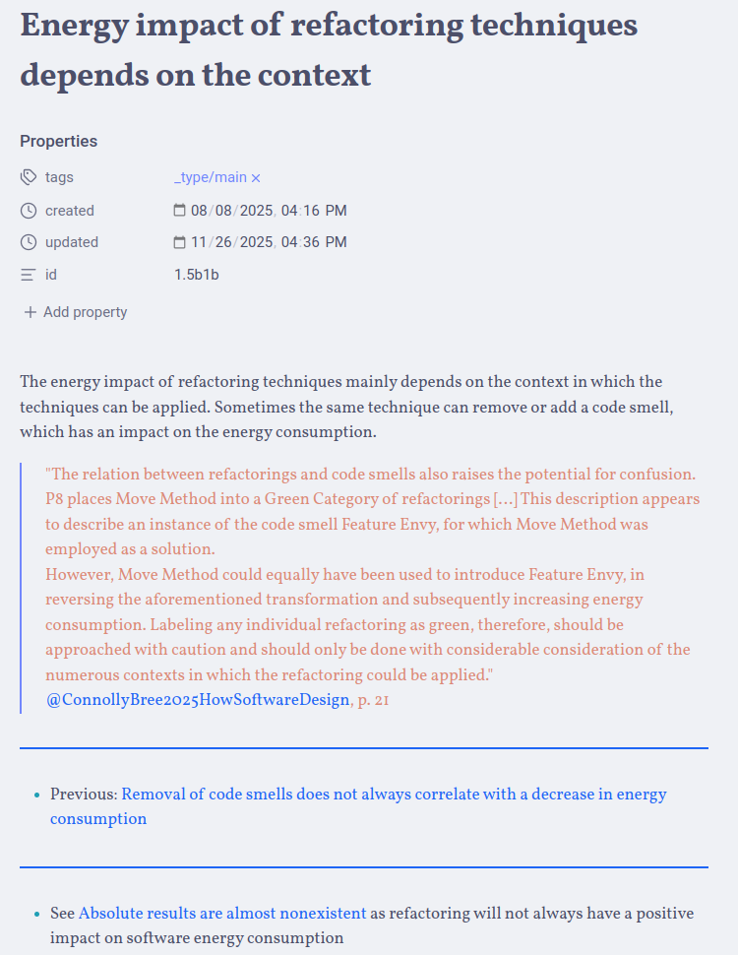
Main notes
Single idea
Quote + reference of the quote
Contextual link to another idea + explanation of why this is relevant to link those two ideas
7

Slide 8
How to create main notes ?
Retype, copy/paste, or reference the quote you want to comment on in a new note, because:
It reminds you of where your idea came from.
It helps you cide wheth your idea is restating the quote or if the idea was merely inspired by the quote (=> determine if/how you cite the source in your state of the art)
Write down your thinking about the passage
Reduce the idea to its essential point => the more atomic an idea, the more broadly you can use it
If you're handling facts:
Restate facts in your own words => Can help begin the process of contextualizing facts and connecting them to other ideas
Say something about the facts => Can help integrate the information into your broader understanding of the topic
Consider the idea's relationship to others of your Zettelkasten (if any), and record any connection as a contextual link => Give context to your links !
8

Slide 9
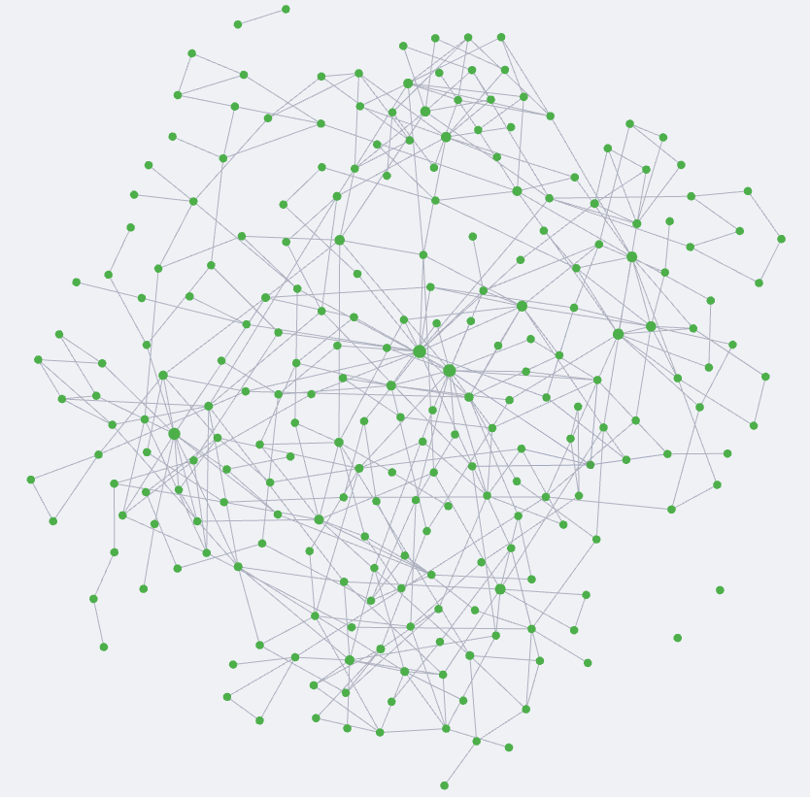
Navigating the anarchy of ideas
A Zettelkasten = anarchic network
Without high-level views, your main notes will seem like a great mess !
How ?
Hub notes
Structure notes
9

Slide 10
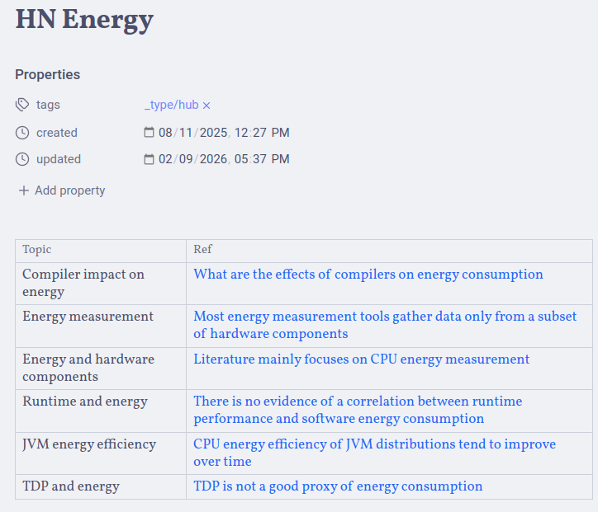
Hub notes
Through time, main notes form trains of thought
=> Sequence of ideas established when notes refer or link to one another
Hub note helps find these trains of thought = access point = highway between topics
Hub note points where things are happening
10

Slide 11
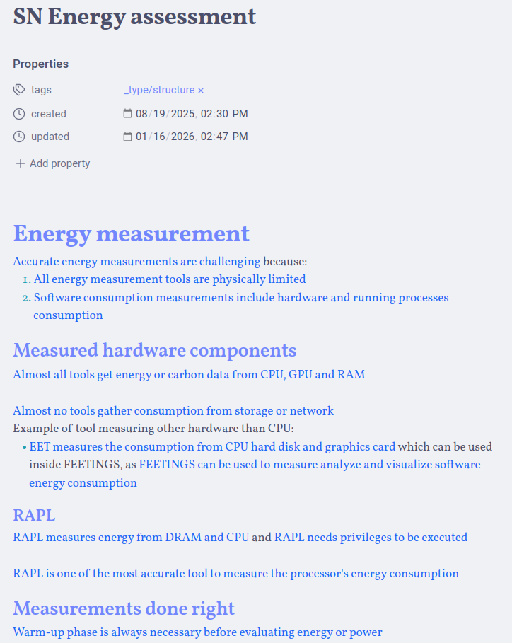
Structure notes
Zettelkasten ≠ hierarchical organization ≠ categories
How can we create coherent arguments?
Structure note = space where related ideas (pulled from the main notes) are organised into semantic coherence
Allows to arrange, edit, copy, add new ideas in ways that make sense for your argument
A structure note provides a foundation for writing (at least) your state of the art
BUT don't let it write your final work for you
Ideas need to be framed in function of the subject you're writing about !
11

Slide 12
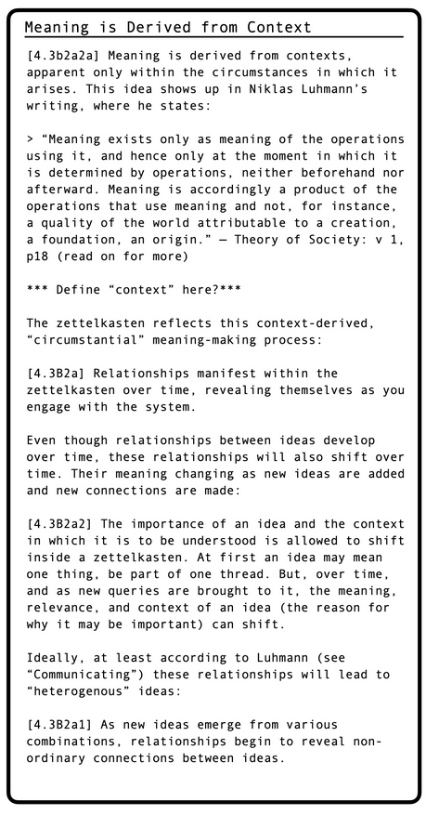
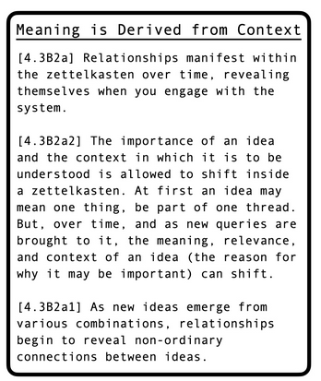
Example of Structure Note
Example from Bob Doto's blog
12

